Slide 1
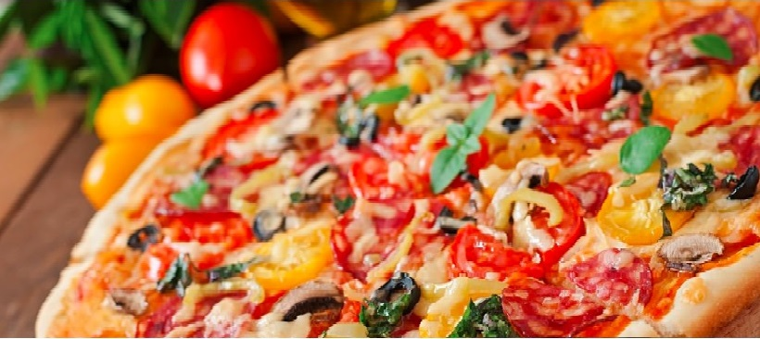
Pizza Sales Analysis Report

Slide 2
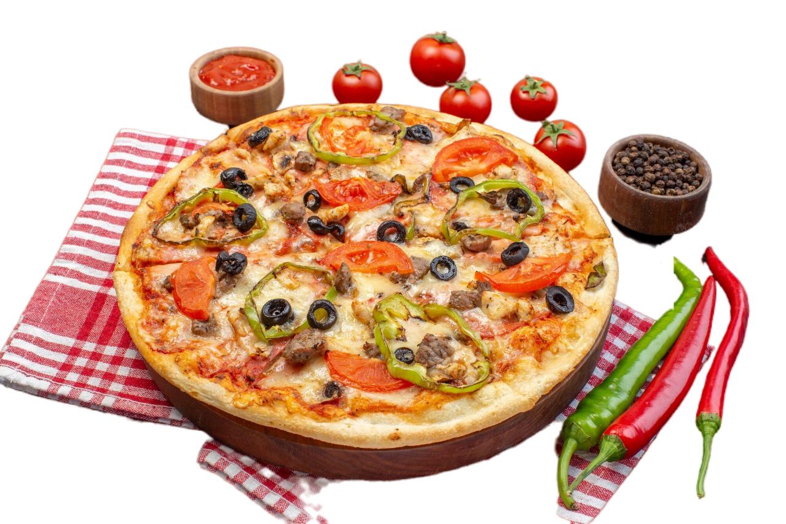
Pizza Sales Insights:
KPI’s Requirements:
Total Revenue
Average Pizzas Per Order
Total Orders
Average Order Value
Total Pizzas Sold
Charts Requirements:
Hourly Trend For Total Orders
Monthly Trend For Total Orders
Quarterly Trend For Total Orders
Percentage of Sales by Pizza Category
Percentage of Sales Pizza Size
Total Pizzas Sold by Pizza Category

Slide 3
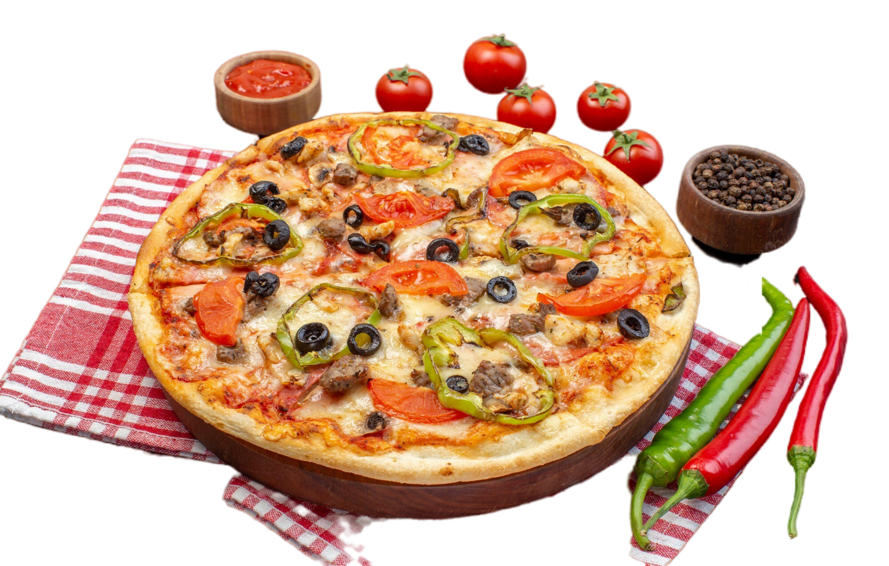
Charts Requirements:
Top 5 mostly Ordered Pizzas
Top 3 Pizzas by Revenue in each Pizza Category
Top 5 mostly sold Pizzas by Quantity
Top 3 highest selling Pizza Sizes
5 lowest sold Pizzas by Revenue

Slide 4
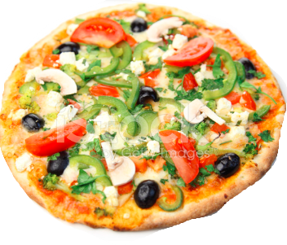
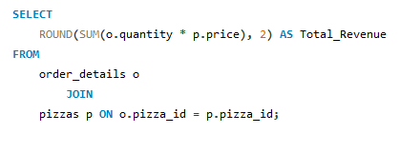
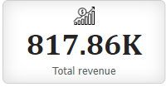
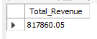
Total Revenue

Slide 5
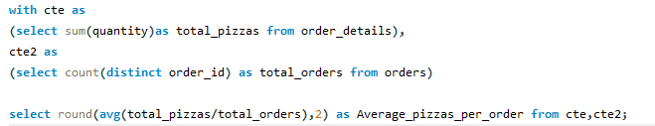
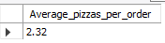
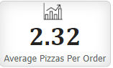
Average Pizzas Sold Per Order

Slide 6
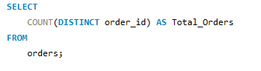
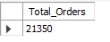
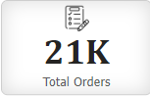
Total Orders

Slide 7
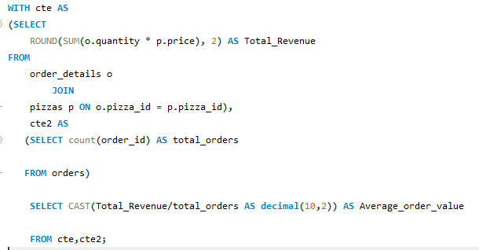
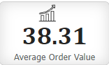
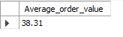
Average Order Value

Slide 8
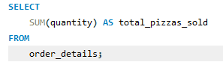
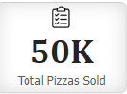
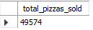
Total Pizzas Sold

Slide 9
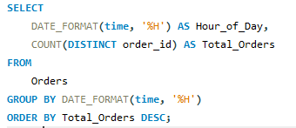
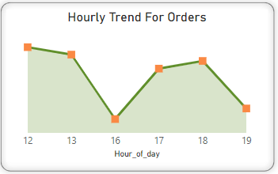
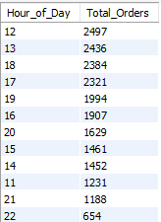
Hourly Trend For Total Orders

Slide 10
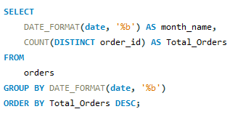
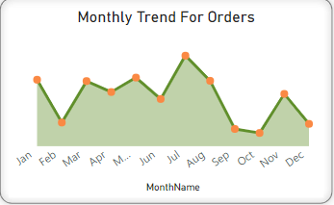
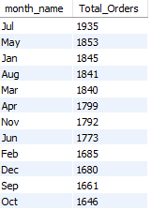
Monthly Trend For Total Orders

Slide 11
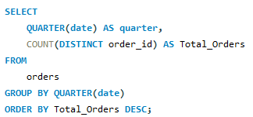
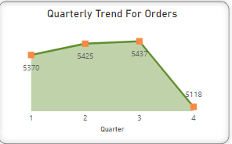
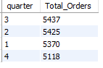
Quarterly Trend For Total Orders

Slide 12
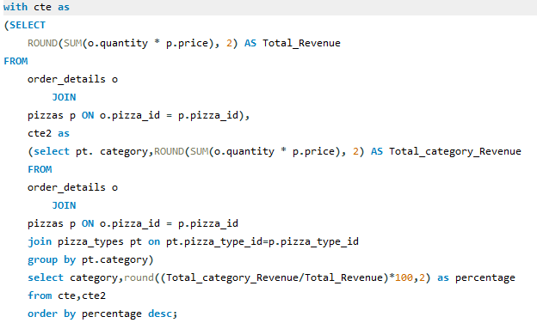
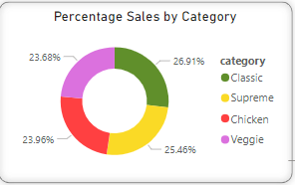
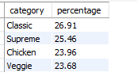
Percentage of Sales by Category

Slide 13
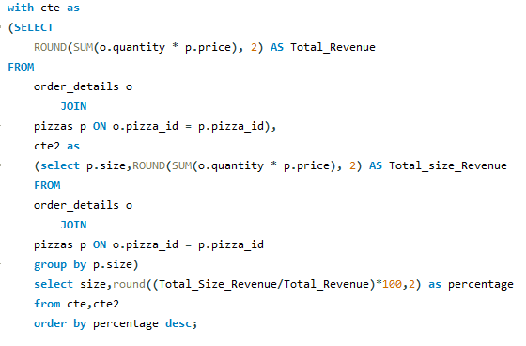
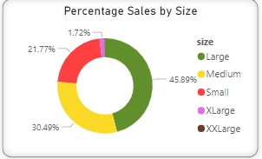
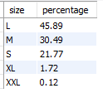
Percentage of Sales by Size

Slide 14
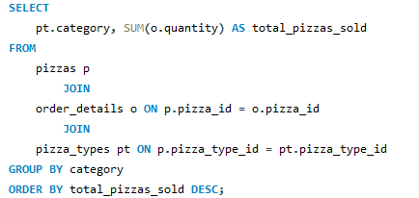
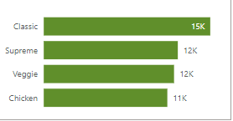
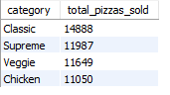
Total Pizzas Sold by Pizza Category

Slide 15
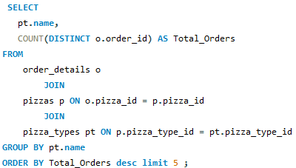
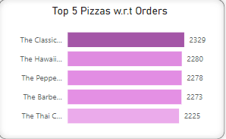
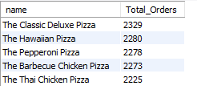
Top 5 mostly Ordered Pizzas

Slide 16
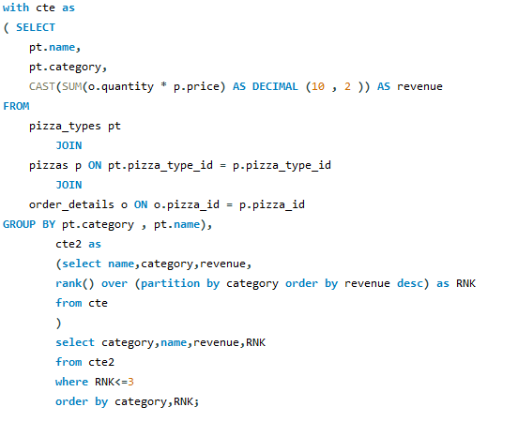
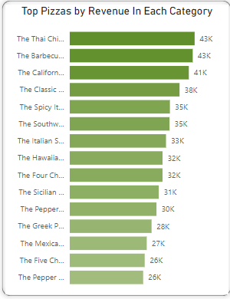
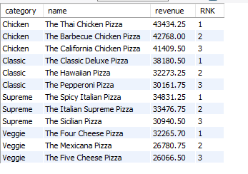
Top 3 Pizzas by Revenue in each Pizza Category

Slide 17
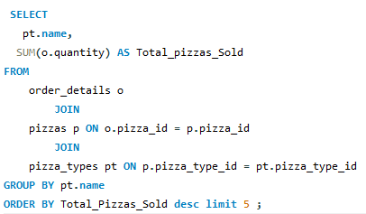
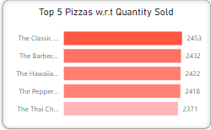
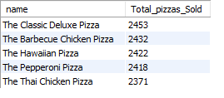
Top 5 Pizzas Sold by Quantity

Slide 18
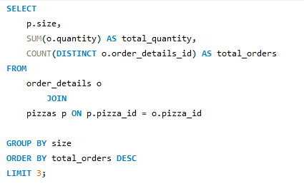
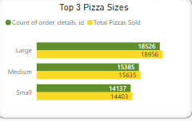
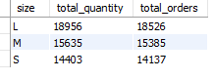
Top 3 Pizza Sizes Sold

Slide 19
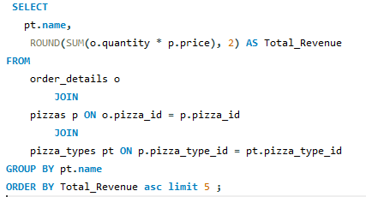


5 Lowest Selling Pizzas

Slide 20

Dashboard Design In Power BI

Slide 21

Dashboard Design In Power BI

Slide 22
Insights:
Hourly Trend for total order shows that in afternoon from 12 pm to 1 pm and in evening from 5pm to 6 pm are the peak hours of the day.
Monthly and Quarterly Trend show that the first three quarters carry the highest ordering trend in which third quarter from July to August is generating most revenue while the fourth quarter is the lowest in terms of generating business revenue.
Classic Pizza category is the mostly ordered and sold category amongst all categories.
45.89% of Large Sized Pizzas contribute to total revenue while XXL size is the least ordered size.
Classic Deluxe Pizza, Hawaiian Pizza and Pepperoni Pizzas are mostly ordered by customers.
Brie Carre Pizza is generating the least revenue amongst all Pizzas.

Slide 23
Recommendations:
Inventory Maintenance: Inventory of highest selling pizzas should be maintained specially during peak hours of the day and in top selling quarters.
Promotional Deals: Different Deals and offers can be introduced during peak selling months to generate more revenue.
Feedback: Customer feedback can help to improve customer service.
New Variety: New varieties of Pizzas can be introduced in place of lowest selling Pizzas to increase revenue.
Digital Marketing: Online Marketing campaigns can boost sales and increase number of customers.
Facilities: Special facilitation should be provided to customers during lunch and evening timings to increase customer churn rate.
Performance Metrics: Regularly review performance metrics and adjust strategies as needed for the best outcome.

